Slide 1
India Road Safety Overview

Slide 2
Outline
India: Road Safety
Facts
Statistics: Road crash fatality and injury data
Key Risk Factors
Where does India stand
Conclusion

Slide 3
India’s Road Network
Motor Vehicles in India
Total registered vehicle till March 2013 was 182 million.
133 mn Two-Wheeler; 25 mn Car, Jeep &Tax; 8.5 mn Goods vehicle; 1.8 mn bus; 14.5 mn Other vehicles.
Presently total motor vehicles registered is estimated to be over 240 mn.
In FY16, Indian automobile industry produced 23,960,940 (23 mn) vehicles.
16.45 mn (80%) TW; 2.79 mn (14%) PV; 0.68 mn (3%) CV; 0.53 mn (3%) 3W.
Total road length in Dec 2016 was 52.32 lakh (5.23 mn) kms.
100,087 kms (NH); 148, 256kms SH; 1300 kms (EW); 467,763 kms major District Roads (DR)
80% passenger and 65% freight traffic carried by roads
Source: Ministry of Road Transport & Highways, Government of India

Slide 4
How people commute to work in India
47.1% people walk, cycle and take bus to work and only 15.4% use private vehicles
Over 75% people travel to work using NMT and some form of public transport/intermediate public transport
Walk: 22.6%
Bicycle: 13.1%
Two-Wheeler: 12.7%
Bus: 11.4%
Train: 3.5%
Auto Rickshaw/Taxi: 3%
Car: 2.7%
Other modes: 1%
No Travel: 30%
Source: Census 2011

Slide 5
Statistics: India Road Crash Fatality and Injury Data

Slide 6
Global impact of road injury
Over 3400 people die on world’s roads everyday and millions of people are injured or disable every year.
50% of all people dying on road are pedestrians, cyclists, and two wheeler riders.
Road traffic crashes are leading cause of death among age group 15–29 years.
90% of road traffic deaths occur in low- and middle-income countries having only 54% of the world’s registered vehicles.

Slide 7
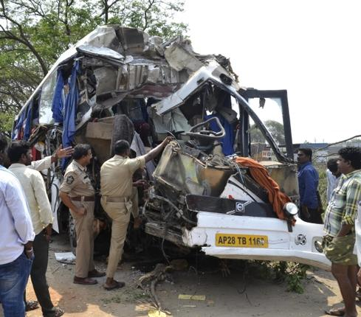
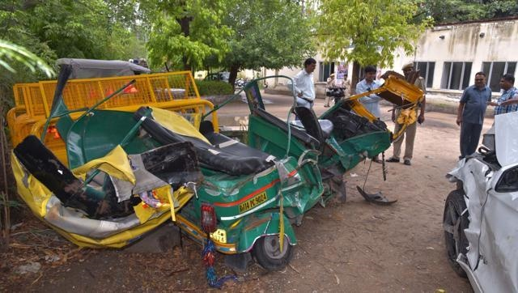
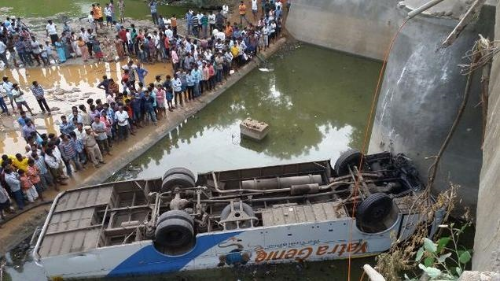
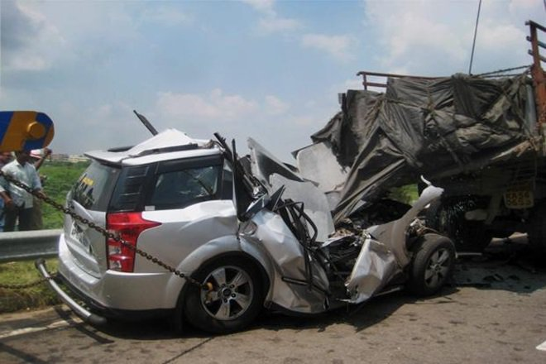
Alarming level of road deaths recorded in India
India registers highest number of road injuries and deaths every year with over 12% of 1.25 million Global road fatalities annually according to WHO.

Slide 8
Road traffic crashes, deaths & Injuries in India (2015)
Road traffic crashes (Accidents): 450,898
Road fatalities : 148,707 (141,256 in 2014)
Road injuries : 477,731
Among death victims, 127,807 were male and 20,886 female.
Everyday 407 people die on Indian roads and 1321 are injured.
National Highways witnessed 49,651 deaths, State Highways 41,219 and Expressways 1849.
Source: Annual Accidental Death & Suicide Report (ADSR) 2015 published by National Crime Records Bureau (NCRB), Ministry of Home Affairs, GOI

Slide 9
States registering highest road deaths & Injuries
STATE | ACCIDENTS | DEATHS | INJURED
Uttar Pradesh | 28,095 | 18,407 | 17,384
Tamil Nadu | 69,059 | 15,642 | 79,746
Maharashtra | 42,250 | 13,685 | 39,301
Karnataka | 44,011 | 10,856 | 56,971
Rajasthan | 24,072 | 10,510 | 26,153
Madhya Pradesh | 40,859 | 9,758 | 40,878
Andhra Pradesh | 22,839 | 8,297 | 29,439
Gujarat | 23,362 | 8,245 | 21,505
Telangana | 21,252 | 7,110 | 22,948
West Bengal | 17,706 | 6,705 | 15,404
Bihar | 9,567 | 5,500 | 6,325
Haryana | 11,174 | 5,045 | 10,619
Punjab | 6,702 | 4,893 | 4,414
Odisha | 10,542 | 4,303 | 11,825
Kerala | 39,014 | 4,196 | 43,468

Slide 10
Largest Cities registering highest road deaths
CITY | ACCIDENT | KILLED | INJURED
Delhi | 8085 | 1622 | 8258
Jaipur | 3151 | 939 | 2892
Bengaluru | 5001 | 890 | 4049
Chennai | 7328 | 886 | 7320
Lucknow | 1277 | 624 | 816
Mumbai | 2551 | 611 | 2289
Allahabad | 1011 | 547 | 660
Agra | 1021 | 545 | 712
Pune | 1553 | 543 | 1050
Kanpur | 1051 | 437 | 889
Pune | 1443 | 438 | 1205
Hyderabad | 2761 | 425 | 2382
Kolkata | 4981 | 421 | 4569
Raipur | 2189 | 448 | 1431
Ahmedabad | 1011 | 387 | 1731
ALL 53 CITIES (Million plus population) | 78,500 | 17,059 | 70,725

Slide 11
Category wise Road Crash deaths Victims
Two Wheeler Driver/ rider: 43,540 (29.3%)
Truck /Lorry : 28,910 (19.4%)
Car & Jeep: 24,272 (16.3%)
SUV/ Station Wagon: 6,096 (4.1%)
Bus: 12,408 (8.3%)
Auto-Rickshaw/ Three-Wheeler:6,915 (4.7%)
Pedestrian, Cyclist & NMT: 10,926 (7.3%)
Tractor: 5,483 (3.7%
Other Motor vehicles: 10,157 (11.1%)
TOTAL FATALITIES: 148,707

Slide 12
Lead causes of road crash deaths in India
CAUSE | ROAD DEATHS | INJURED
Speeding | 60,969 (43.7%) | 292,882
Dangerous Driving | 48,093 (31.4%) | 146,059
Driving under influence of Alcohol/ Drugs | 2,988 | 7,061
Weather conditions | 6,191 | 17,235
Mechanical defect in Vehicle | 4,551 | 13,444
Vehicles parked on road shoulders | 1,663 | 4,012
Defect in road conditions/ Poor road infrastructure | 1,435 | 4,325
Physical fatigue of drivers | 1,188 | 3,273
Animal crossing | 1,019 | 2,292
Other causes | 16,947 | 56,259
Causes not known | 3,663 | 7,832
TOTAL | 148,707 | 464,674
Source: ADSI Report 2015, NCRB, MoHA, GOI

Slide 13
Fault wise road deaths & injuries
CAUSE | ROAD DEATHS | % SHARE | INJURIES | % SHARE
Drivers' fault | 106,021 | 72.6 | 401,756 | 80.3
Other vehicle drivers' fault | 6,961 | 4.8 | 19,686 | 3.9
Cyclists' fault | 1,384 | 1 | 2,928 | 0.6
Pedestrian fault | 2,690 | 1.8 | 5,962 | 1.2
Defect in condition of Motor Vehicle | 4,127 | 2.8 | 9,818 | 2
Defects in road conditions | 2,733 | 1.9 | 6,122 | 1.2
Weather condition | 2,552 | 1.7 | 4,792 | 1
Passenger fault | 2,657 | 1.8 | 6,265 | 1.2
Poor light | 2,095 | 1.4 | 4,809 | 1
Falling of boulders | 505 | 0.3 | 966 | 0.2
Neglect of Civic bodies | 416 | 0.3 | 902 | 0.2
stray animals | 579 | 0.4 | 2,044 | 0.4
Other causes/ not known | 13,413 | 9.2 | 34,229 | 6.8
TOTAL | 146,133 | 100 | 500,279 | 100

Slide 14
Age wise victims
Below 17 years: 15,633 Persons killed
18-30 years: 51,787
30-45 years: 47,087
45-60 years: 25,821
60 years & above: 8,379
Sources: ADSI Report 2015, NCRB, MoHA, GOI
Notes:
Premature deaths among people very unfortunate and have catastrophic impact when they are in their most productive age, caretakers of their families/communities, and contributors to the social and economic growth of their nation.

Slide 15
Key Risk Factors associated with road crash deaths & injuries

Slide 16
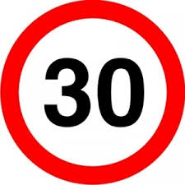
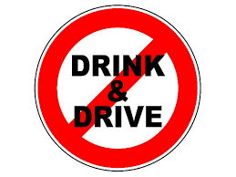
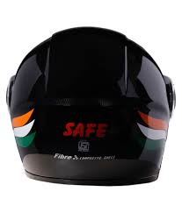
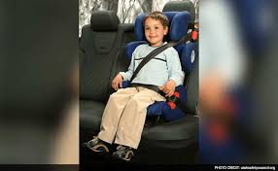
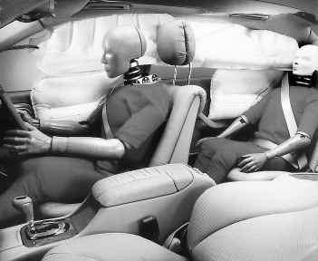
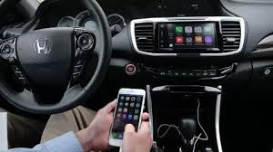
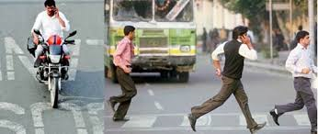
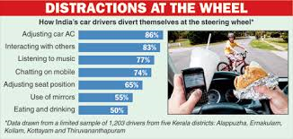
Speeding
Drink driving
Helmets
Seat belts
Child restraint systems
Using Mobile while driving/ Distracted driving

Slide 17
Speeding
Speeding is the biggest cause of road fatalities on India. As per the NCRB Report, in year 2015, Speeding resulted in 60,969 deaths and dangerous driving 48,093 comprising 109,062 (75%) of road crash deaths (148,707).
Section 112, 183 , 184 and 189 of Motor Vehicle Act, 1988 deal with Speed and dangerous driving violations in India. Besides Section 279 of Indian Penal Code also used to register cases of rash & negligent driving.
Present penalty amount prescribed in law is Rs.400 for 1st offence and up to Rs.1000 for subsequent offence for driving over speed limit. For driving dangerously Rs.1000 fine or 6-months jail or both in 1st offence and Rs.2000 fine or 3-years jail or both for subsequent offence.
Proposed in the MVA Bill 2016 are Rs.1000-2000 for 1st offence for LMVs and Rs.2000-4000 for M&HMVs. Driving Licence can be cancelled.

Slide 18
Speeding..
Speed increases likelihood of getting involved in road crash and injury because:
- As speed increases, distance travelled during driver’s REACTION time increases and DISTANCE needed to stop increases
- Higher the speed, greater the RISK of a severe crash
Higher speeds increase likelihood of serious injury or death for pedestrians, cyclists, and two-wheelers.
A 5% cut in average speed can result in 30% reduction in number of fatal crashes.
Effective measures to address vehicular speed
- Speed limit of 45-50 km/hr in cities and 25-30 kms/hr on roads where pedestrians and other vulnerable road users are present
- Traffic calming measures in road designs and pedestrian protections on all motorized vehicles.
Source: WHO Global Status Report on Road Safety 2015

Slide 19
Drink Driving
Drink Driving/ Driving under influence of alcohol caused around 3000 road deaths in 2015.
Section 185 of MVA deals with drink driving violations in India. It prohibits driving with Blood Alcohol Concentration (BAC) level of above 30 MG/100 ML.
Present penalty amount prescribed in MV Act 1988 is fine up to Rs.2000 or imprisonment for up to 6 months or both. For subsequent offense, fine up to Rs.3000 or imprisonment for up to 2 years or both.
Proposed in the MVA Bill 2016 are fine of Rs.10,000, imprisonment up to 6 months or both for 1st offence and Rs.15,000, up to 2 years imprisonment or both. Licence can also be suspended for 3 months.

Slide 20
Drink Driving..
Drinking alcohol and driving increases the risk of a road traffic crash.
Alcohol alters functioning of body and mind and impairs judgment.
Impairment due to alcohol consumption leads to poor judgment, increased reaction time, lowered vigilance and decreased ability to see well.
Lowering the permissible limit of Blood Alcohol Concentration (BAC) while driving, specially for young and novice drivers coupled with strict enforcement significantly reduce road traffic crashes and injuries.

Slide 21
Helmet
India registers maximum road deaths among Two-Wheeler (Motorcycle & Scooter) drivers and pillion riders. Maximum deaths in Two-Wheeler category are because of head injuries.
43,540 two-wheeler riders died and 148,131 injured in year 2015.
Section 128 and 129 of MVA make Helmet mandatory while driving/riding a Two-Wheeler.
Penalty for not wearing Helmet is Rs.100 for 1st offence and Rs.300 or for subsequent offences.
In the MVA Bill 2016, through insertion of new Section 194C and 194D, penalty of Rs.1000 and disqualification of licence for three months proposed for not wearing protective headgear (Helmet) while riding a two-wheeler.

Slide 22
Helmet..
Not wearing helmet while driving or riding on a motorized Two Wheeler increases the risk of sustaining a head injury, severity and death.
Wearing a good-quality helmet can reduce risk of death from a road crash by 40% and severe injury by over 70%.
Having a provision for Child protection and appropriate headgear will save lives of many children commuting on Two-wheelers.
“The rider of a motorized two-wheeler that is moving, or is stationery but not parked, must wear an approved helmet securely fitted and fastened on the rider’s head. A rider includes the driver and the passengers”.

Slide 23
Seat Belt & Child Restraint System
In 2015, around 20% victims (30,368) of road crash fatalities were Car, Jeep & SUV drivers/ passengers. A lot of these fatal crashes happen due to not wearing seat belts or child safety systems.
Rule 125 (1A) of CMVR makes it mandatory for four wheelers to have drivers/ passengers seat belt.
Penalty imposed for not wearing seat belt is Rs.100 and Rs.300 or for subsequent offences under MVA section 177.
In the MVA Bill 2016, through insertion of a new Section 194B, penalty of Rs.1000 and disqualification of licence for three months proposed for wearing safety belts for driver and passengers in motor vehicle.
This provision also makes it mandatory for driver of a motor vehicle driven with a Child below 14 years that child is secured by a safety belt or Child restraint System.

Slide 24
Seat Belt & Child Restraint System..
SB & CRS are secondary safety measure and reduces risk of hitting interior of car or other passengers. It also reduces risk of ejection from the vehicle.
Driver as well as front seat and rear seat passengers must be required to fasten seat belt while vehicle is in motion.
Wearing seat-belt reduces risk of fatal injury by up to 50% for front seat occupants and up to 75% for rear seat occupants.
Mandatory use of Child restraints (Infant seat/ child seat) can reduce child deaths by 54–80% in event of a crash.
Placing the child in a Child restraint system appropriate for her/his age, weight, and height is the safest way of restraining a young child in a car.

Slide 25
Where does India stand in road safety policy formulation

Slide 26
Important developments on Road safety
As a signatory to Brasilia Declaration (Nov 2015), India is committed to reduce the number of road accidents and fatalities by 50% by 2020.
Acting upon Public Interest Litigation, in 2014 the Supreme Court of India appointed a 3-member Committee to measure and monitor the implementation of road safety laws in the country.
The Supreme Court appointed Committee on Road Safety (SCCRS) have issued several directions during last 2 years to all the states to make necessary amendments in their respective state Motor Vehicle Rules.
States have made some amendments in their Motor Vehicle Rules and also adopted Road Safety Policy in line with National Policy.

Slide 27
GOM Transport
A Group of Ministers (GOM), comprising transport ministers and Secretaries from different states of India, was constituted in March 2016 by the Government. Chaired by the Transport & PWD Minister of Rajasthan, GOM was asked to examine best practices in road safety and road transport sector and suggest actionable points for implementation.
GOM also reviewed the current Motor Vehicle Act 1988 of India, Central Motor Vehicles Rules 1989, State MV Rules and carried out several consultations with various stakeholders for four months, and submitted its report with over recommendations to the Ministry of Road Transport & Highways (MoRTH).
Accepting majority of their suggestions, Government drafted a Motor Vehicle (Amendment) Bill 2016 which was approved on 3rd August by the Union Cabinet Chaired by Prime Minister.
The bill provides for increased penalties in case of traffic violations along with several amendments and new additions in the present MVA. Government is aiming to make substantial reduction in the number of road traffic related injuries and fatalities after the passing of this bill in Parliament.

Slide 28
Motor Vehicle (Amendment) Bill 2016
After GOM’s input MVAB was introduced by the Union Minister of Road Transport & Highways in Lok Sabha on 9th August.
Bill was referred to 31-member Parliamentary Standing Committee (PSC) on Transport on 18th August for detailed consideration, review, and consultation with all stakeholders.
PSC has held several meetings with its member MPs and with senior officials of Transport Ministry, State Transport Secretaries and other stakeholders to hear their views and suggestions on proposed amendments in the MVA Bill.
PSC is likely to submit report during ongoing Budget Session of Parliament.
The Bill is listed for consideration and passing in Lok Sabha .

Slide 29
Motor Vehicle (Amendment) Bill 2016..
In the present Motor Vehicle Act, there are 223 Sections out of which the Bill aims to amend 68 sections. The Bill also proposes insertion of 28 new sections.
The amendments mainly focus on issues relating to improving road safety, citizens’ facilitation while dealing with the Transport Department.
The Bill propose to improve the transport scenario in the country by permitting the States to grant exemptions in Stage carriage and contract carriage permits for promoting rural transport, public transport, last mile connectivity and for passenger convenience and road safety.
To improve the registration process for new vehicles.

Slide 30
Motor Vehicle (Amendment) Bill 2016..
The MVA Bill proposes to increase penalties and punishment to act as deterrent against traffic violations. Stricter provisions are being proposed in respect of offences like juvenile driving, drunken driving, driving without licence, dangerous driving, over-speeding, overloading .
Stricter provisions for helmets have been introduced along with provisions for electronic detection of violations.
The Bill proposes that the State Government can specify a multiplier, not less than one and not greater than ten, to be applied to each fine under this Act and such modified fine.
To help the road accident victims, Good Samaritan guidelines have been incorporated in the Bill.

Slide 31
Motor Vehicle (Amendment) Bill 2016...
The important provisions include increase in compensation for Hit & Run cases from INR 25000 to INR 2 lakhs. It also has provision for payment of compensation upto INR10 lakh in road accidents fatalities.
The driving training process has been strengthened enabling faster issuance of transport licenses. This will help in reducing the shortage of commercial drivers in the country.
To bring harmony of the registration and licensing process, it is proposed to create National Register for Driving Licence and National Register for Vehicle registration through “Vahan” & “Sarathi” platforms. This will facilitate uniformity of the process across the country.
The process for testing and certification for automobiles is proposed to be regulated more effectively. The testing agencies issuing automobile approvals have been brought under the ambit of the Act.

Slide 32
Conclusion
India’s economic, road, and transportation infrastructure growth, and need to ensure safety goes hand in hand with development.
Comprehensive Road Safety Policies on key behavioural risk factors and their implementation can significantly improve road safety in India.
Data and trends suggest that focusing on Speeding, Drink driving, Helmet, Seat belt, and Child safety systems can help reduce large number of road injuries and deaths among Two-wheeler riders, car drivers/occupants.
Evidence shows from around the World that Countries can effectively tackle road injuries by adopting & implementing policies on risk factors. They proved low investment measures demonstrating faster and sustainable impact.

Slide 33
Conclusion..
A good and visible enforcement plan and taking community and all stakeholders along at every stage are crucial for the success of road safety.
Government of India deserves appreciation for taking some big road safety initiatives during last two years such as bringing the Motor Vehicle (Amendment) Bill, making commitment at international forum to reduce road fatality by 50%, and launching scheme on rectifying black spots massively among other things.
Government should also ensure that adequate provisions on safety of Children, women, elderly, pedestrians, two-wheeler riders and other vulnerable road users are incorporated in the final bill.

Slide 34
Thank you
Questions/suggestions
nalin2020@gmail.com

