Slide 1
PARISAR
Accidents, mythologies & science of traffic safety
Dinesh Mohan
Mumbai, 11 March 2017

Slide 2
“Action in the absence of knowledge can be dangerous and worse than no action at all”
M. K. Gandhi

Slide 3
Magnitude of the problem
~8 %
NO RELIABLE OFFICIAL STATISTICS AVAILABLE ON:
FATALITIES BY ROAD USER TYPE
VEHICLES INVOLVED
NUMBER DISABLED
NUMBER INJURED
~6 %
~4 %
> 400 persons killed every day
~ 1,200 permanently disabled every day
~ 8,000 hospitalised everyday

Slide 4
Road traffic fatalities in Japan, The Netherlands, U.K. and U.S.A. 1950-2010.

Slide 5
The reduction in accidents in all these modes after 1965 is probably not due to any single factor in isolation
Due to a wide variety of improvements:
  design of vehicles/technology
  operating environment and infrastructure
  enforcement of safety regulations and standards
What changed 1900-1960 and 1960-2000?

Slide 6
Paradigm shift
Severe Punishment
Did not work up to ~1970
A move from focus on blaming people, hectoring people,
‘educating’ them, punishing them
Treating people as ‘normal’ & focusing on the system

Slide 7
FATALITIES/100,000 PERSONS
WHO ESTIMATES 2015
THAILAND
IRAN
TANZANIA
KUWAIT
INDIA
MEXICO
EGYPT
USA
JAPAN

Slide 8
SUMMARIES OF STUDIES
There is no clearly proven relationship between knowledge and attitude on the one hand and behaviour on the other hand – OECD 1994
Education programs by themselves usually are insufficient to change behaviour. They may increase knowledge, but increased knowledge rarely results in an appropriate behaviour change – O’Neill 2001
Contrary to the view that education cannot do any harm some of these programs have been shown to make matters worse – Sandels 1978

Slide 9
Education of pedestrians
http://www.cochrane-injuries.lshtm.ac.uk/

Slide 10
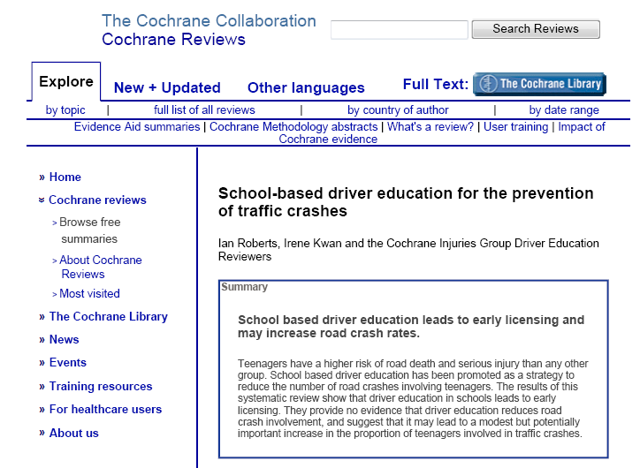
School based driver education
http://www.cochrane-injuries.lshtm.ac.uk/

Slide 11
The Zero Vision
October 1997, Road Traffic Safety Bill, Swedish Parliament
“The scientific basis of the zero vision differs from the usual approach to safety in human-machine systems: designing a system to minimize the number of events that cause injury. Instead, the zero vision is based on the notion of "allowing" these incidents to occur, but at a level of violence that does not threaten life or long-term health”
“In the zero vision, the entire transport system must be designed to accommodate the individual who has the worst protection and the lowest tolerance of violence. No event must be allowed to generate a level of violence that is so high that it represents an unacceptable loss of health for that vulnerable individual.”
“The responsibility for every death or loss of health in the road transport system rests with the person responsible for the design of that system. This is the ethical basis for realizing the zero vision.”
        CLAES TINGVALL

Slide 12
Car going over the speed
Limit
Motorcyclist not wearing helmet dies
279…Rash and negligent driving
304…Culpable homicide not amounting to murder
Teach people and punish them

Slide 13
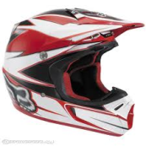
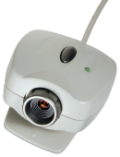

Bright light at junction
Roundabout
Speed camera
Police presence
Helmet compulsory

Slide 14
THE INDIAN SITUATION
VALUE OF LIFE AND AWARENESS
Awareness: people fed up with frequency of death and injury – violence a symptom of concern?
Value of life: Willingness to keep treatment going even after bankruptcy – infinite?
Punishment: severe and immediate – effect on crash rates?

Slide 15
Fatalities per million persons – states and UT
“Culture” does not seem to be a determining factor

Slide 16
Traffic fatality rates in cities with populations of at least one million, 1991, 2001, 2011
Source: NCRB, 2016
Increase 2-5 times in 5 years in many cities

Slide 17
Fatalities by road user type
Car
4%
Notes:
Agra ped and bus high, but rate much higher

Slide 19
Traffic fatalities by road-user type on national highways
Source: Mohan, Tiwari & Bhalla, 2015

Slide 20
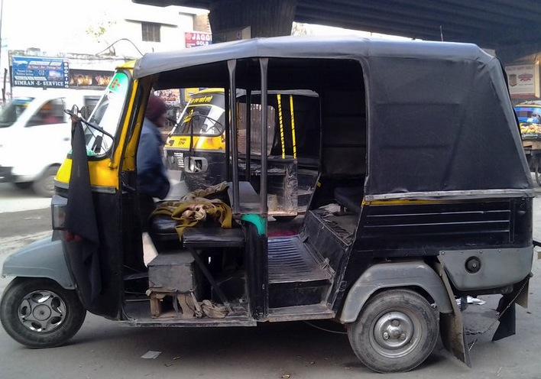
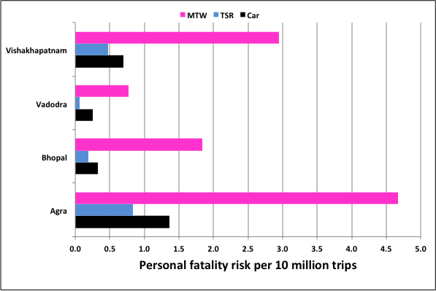
Personal risk estimate
Assumption - occupants per vehicle per day
MTW-4 TSR-60 Car-7
Mohan, D, Tiwari, G, Mukherjee, S 2013

Slide 21
Probability of pedestrian fatality by impact speed
CAR OCCUPANT
Speed limits
Residential and business areas: 30 km/h
Urban arteries: 40-50 km/h

Slide 22
Best buys in road safety
  Speed reduction
  Seat-belts
  Child-restraints
  Helmets
  Day time running lights M/C
  Drinking and driving checks
  Low cost engineering measures
  Safer vehicles
Laws
Enforcement
Standards
Behavior

Slide 23
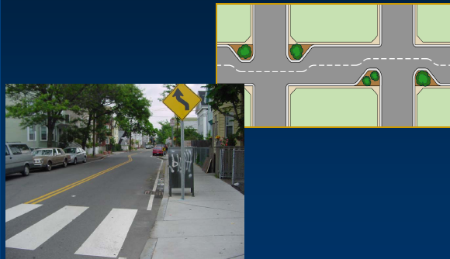
Speed reduction
  Urban speed limits on arterial roads should
  not exceed 50 km/h
Traffic calming on all other roads
Only 29%
of countries
have such
laws!
IIT Delhi 20 October 2013

Slide 24
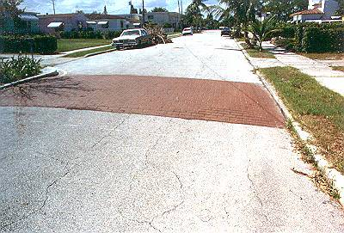
Pedestrian crossings raised 10 cm above road level and speed breakers every 80m
“speed humps were associated
with a 53% to 60% reduction in the odds of injury or death among children struck by an automobile in their neighborhood”
American Journal of Public Health, April 2004

Slide 25
Drinking and driving
BACs should be set at 0.03 g/dl for the general population.
Less than
50%
of countries set
this limit!

Slide 26
Self-reported drink-driving behaviour
Country | Drink-driving in the past month | Checks per million population per day
ITALY | 59% | 521
FRANCE | 45% | 521
SPAIN | 42% | 307
GERMANY | 33%
NETHERLANDS | 32%
FINLAND | 13% | 1,329
SWEDEN | 8% | 886
Most effective
Mumbai: Population 20m, needs 10,000 vehicles checked per day
European Commission, DG for Mobility and Transport

Slide 27
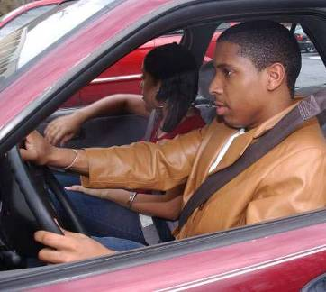
Seat-belts and airbags
Wearing a seat-belt reduces the risk of death among front-seat passengers by 40−65% and among rear-seat occupants by 25−75%.
Only 57%
of countries
require seat-belts
(front & rear)!

Slide 28
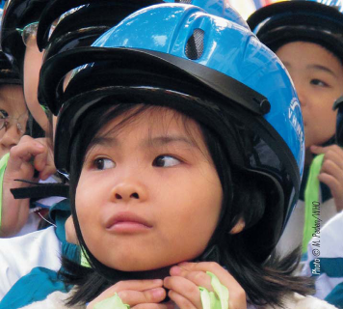
Motorcycle helmets
Wearing a good quality motorcycle
Helmet can reduce the risk of death by ±40% and severe head injury by >70%.
Only 40% of
countries have a comprehensive
law and standards!

Slide 29
Use headlights
during the day
It reduces deaths
by 10 - 15%

Slide 30
1988 Motor Vehicles Act – Possibilities
(29 years ago)
Compulsory helmet law
Strict control of drinking and driving
Motor vehicle safety regulations
Speed regulations
Safety Item Lives saved
Compulsory helmet use and DLR, 1990 3,50,000
Bright bicyes (eg yellow), 1990 25,000
Safer vehicles, seatbelts/airbags, 2000 1,00,000
Mild speed and alcohol control,1990 2,50,000
TOTAL (25,00,000) ~ 7,50,000

Slide 31
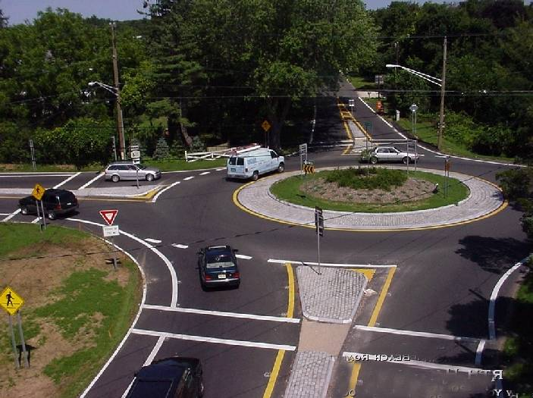
Roundabouts reduce fatalities ~ 70-80%
& Pollution about 30%

Slide 32
Safe roads a precondition for the future
Children, elderly, walking speed ~ 0.8 m/s
Pedestrian green phase < 30 s
Therefore, motorised lanes < (30 X 0.8) = < 24 m
Shops and/or street vendors by design
City blocks ~ 800 m square
Maintain urban average speeds at 15 km/h
Public transit on surface

Slide 33
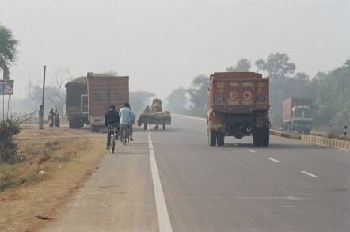
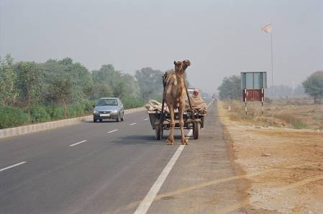
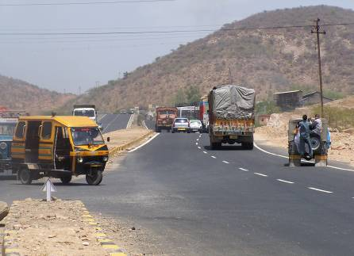
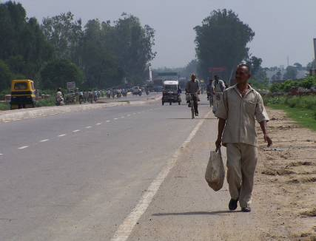
Highway safety??
Highways being constructed without consideration for actual modal share

Slide 34
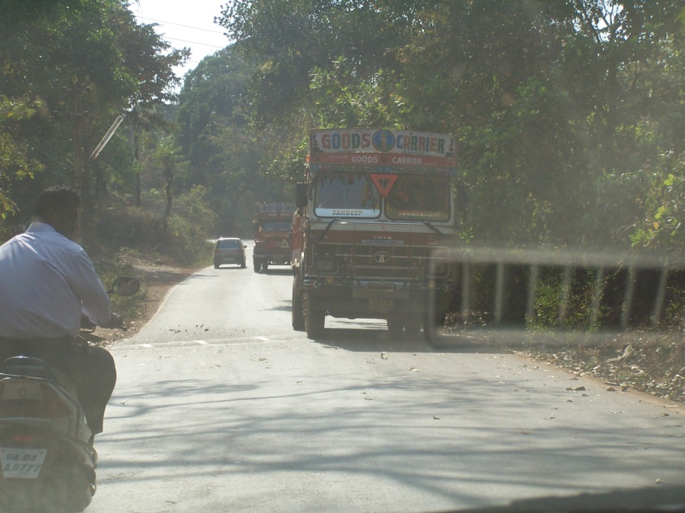
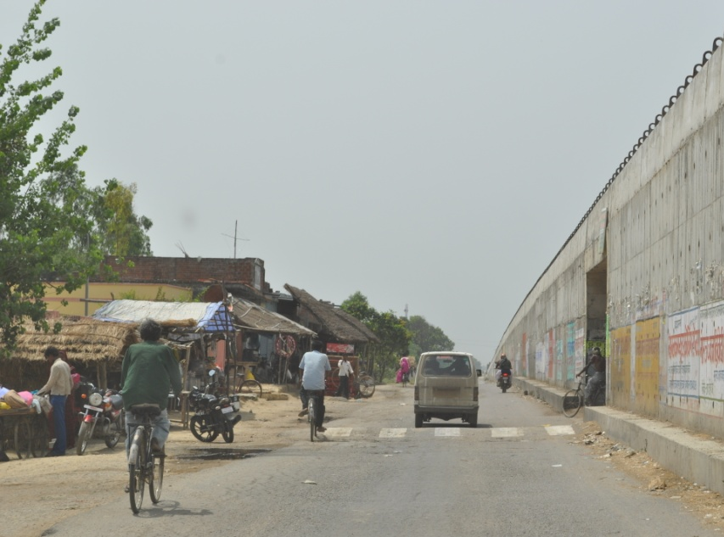
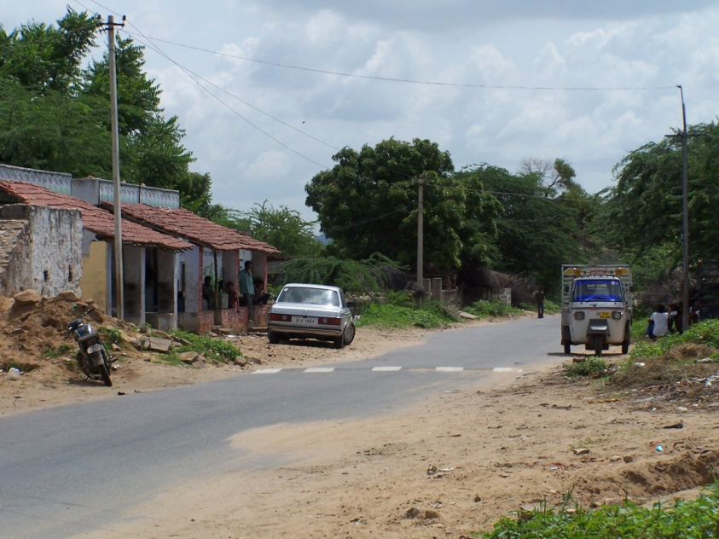
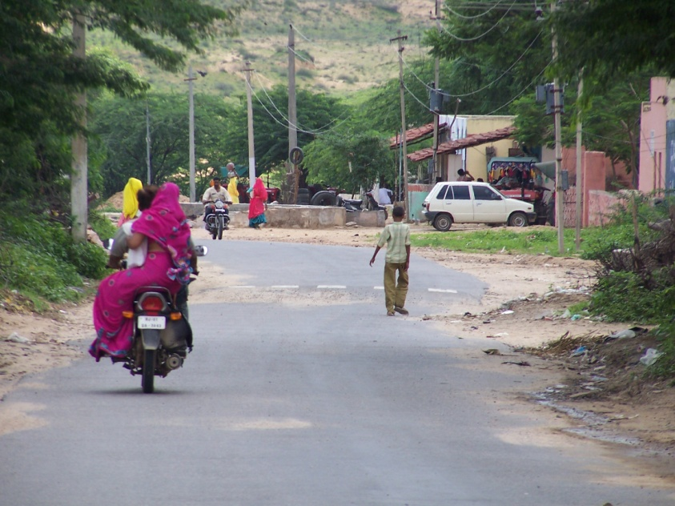
“Illegal” speed humps on roads through villages in India – construction forced by villagers
Safety without increase in per capita income or “education”
Probably saves ~ 20,000 lives per year

Slide 35
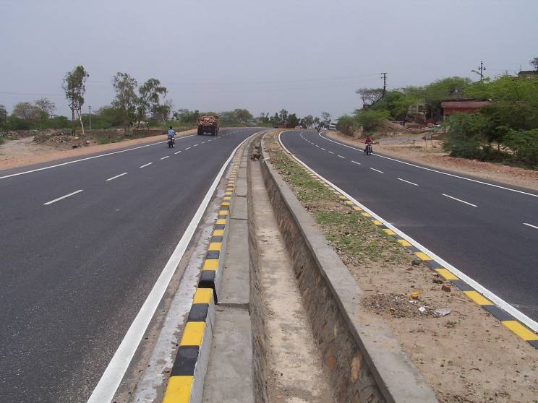
Dangerous Medians

Slide 36
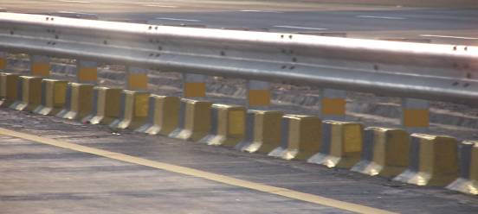
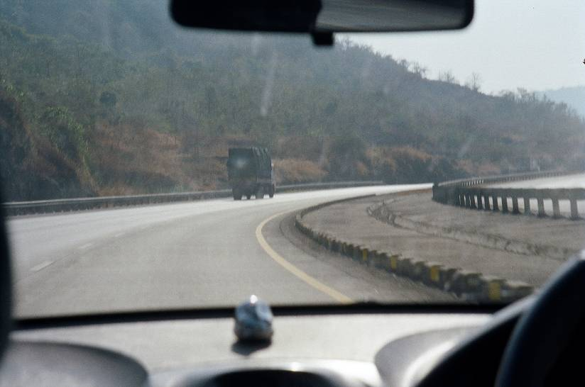
Dangerous Medians

Slide 37
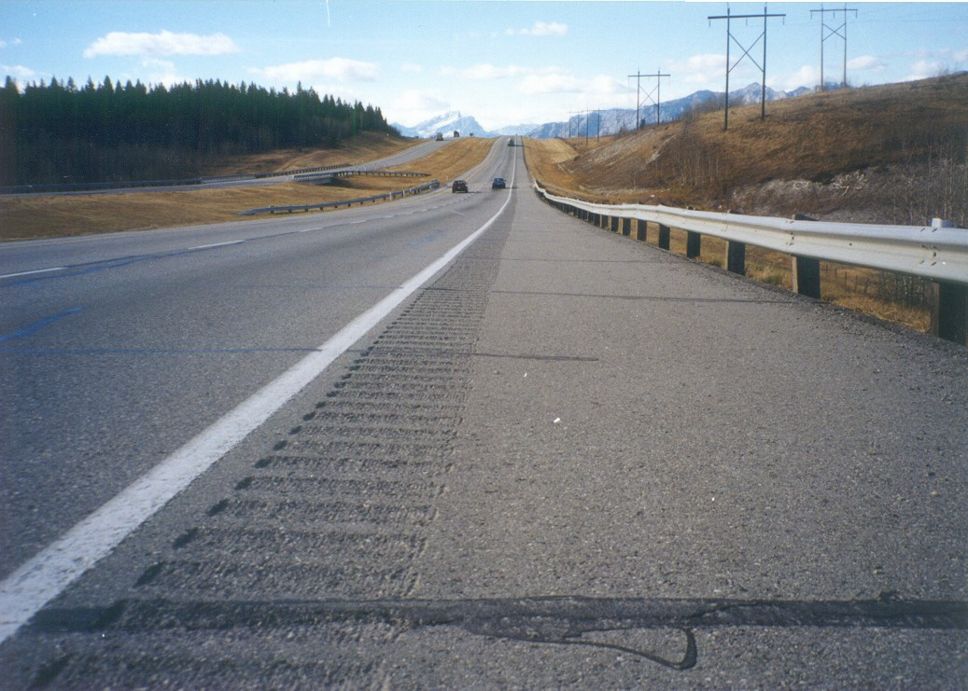
Safer highway

Slide 38
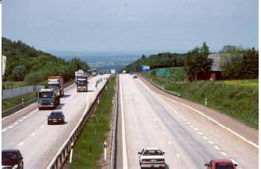
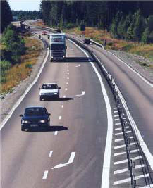
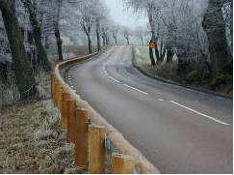

Slide 40
Salient features of new Bill
Most fines increased 5 times, some more
Combination of enforcement and penalties prevent the violation of traffic regulations and increase road safety. However, the most common type of penalty at the present time, a fine, has been found to have little effect
Road users adapt their behaviour without having already been punished. In particular, frequently conducted and very visible traffic checks, which are unpredictable in terms of time and place and are combined with public information campaigns, bring about the general prevention of traffic violations
SWOV Fact sheet...Penalties in traffic. SWOV (Institute for Road Safety Research), Leidschendam, The Netherlands,January 2009

Slide 41
Salient features of new Bill
More jail sentences and easier suspension of license
It is suggested that substantial increases in fines and licence disqualifications would have limited potential in deterring recidivist offenders. ..
The present analysis, failed to find any evidence for a significant relationship between fine amount and the likelihood that an offender will return to court for a new driving offence
Briscoe, S., (2004). Raising the bar: can increased statutory penalties deter drink-drivers? Accident Analysis & Prevention 36, 919-929
Conclusions: The overall pattern of results suggests a possible effect of mandatory fine policies in some states, but little effect of mandatory jail policies
Wagenaar, A. C., Maldonado-Molina, M. M., Erickson, D. J., Ma, L., Tobler, A. L., Komro, K. A., (2007). General deterrence effects of U.S. statutory DUI fine and jail penalties: Long-term follow-up in 32 states. Accident Analysis & Prevention 39, 982-994.

Slide 42
Summary of penalties in high income countries with low fatality rates
Summary for all countries studied | US$ | Prorated for Indian Driver Income (Rs)
Lowest penalty (eg parking) | ~50 | ~200
Not wearing seat belt | ~50 | ~200
Speeding | ~100 | ~500
Drinking and driving | ~200-1,000 | ~1,000-5,000
Highest penalty | ~2,000 | ~10,000
US average one day per capita income $ 135
Most drivers’ income ~ Rs 15,000 per month
Indian one day income ~ Rs 500

Slide 43
Major flaw in policy
No policy for establishing expertise
Presently
  Number permanent safety experts in Central or State Government…..……..……0
  Number of research centres established by a government agency in universities…0
  Number of permanent safety experts in NHAI…………………………………………….0
  Extra funds for policing and expertise...…0

Slide 44
Good News
Done without new Bill
Central Motor vehicles (Fourteenth Amendment) Rules. 2015: Two wheelers exceeding i25cc manufactured on and after the 1st April, 2017 will be fitted with antilock braking system and not exceeding l25cc shall be fitted with combined braking system
Central Motor Vehicles (Second Amendment) Rules, 2016: two wheeler manufactured on and after the 1st April, 2017, shall have one or two head lamps which shall automatically switch on when the engine is running
Notification 28th April, 2015: Protection of occupants in Offset Frontal Collision, lateral collision, and pedestrian protection, 1 Oct 2017

Slide 45
Way Forward
TODAY
Esatblish National Road Safety and Traffic Management Board
TOMORROW
Enforcement of helmet laws – ~15,000 lives
Daytime headlight for two-wheelers – ~10,000 lives
Seatbelt all car users – ~ 7,000 lives
No free left turns in urban areas
Speed control by road design and enforcement ~15,000 lives
Drinking and driving control by enforcement ~10,000 lives
No children in front seat
PERMANENT JOBS FOR EXPERTS AND RESEARCH CENTRES
DAY AFTER TOMORROW
New safety standards for roads and highways
Pedestrian paths and cycle lanes on all arterial roads
Annual targets for broadening pedestrian paths on all arterial roads
Annual targets provision of bicycle lanes
Service lanes on all highways
Modification of raised medians
WWW.ICORSI.org
IIT Delhi March 17

